Slide 1



ABFRL Galerieslafayette Web TSD
13th June 2025

Slide 3
Guidelines to Implement Tagging
Adobe Launch script should be placed inside the global head tag.
Copy and paste the digitalData as it is without changing the Camel Casing.
Direct call rule(_satellite.track("<rule name>"); to be triggered after the respective datalayer is updated.
Datalayer should be populated before DOM ready.
Amount related values should be passed in amount format. Eg : product price, order amount, product/order discount
<> this indicates dynamic value to be captured and passed.
Icid will be added to the next page’s URL where user lands after clicking any content of current page.
Testing will be performed by Team Implementation after ABFRL QA team will give the confirmation/sign off for the testing done by them.
UAT should be done first in staging and then in production post production UAT adobe’s codes are pushed to live.
For Customer ID, pass the value only when available else pass it as blank.
All Product values should be consistent for every product for entire website.
All the values should be passed in lowercase only

Slide 4
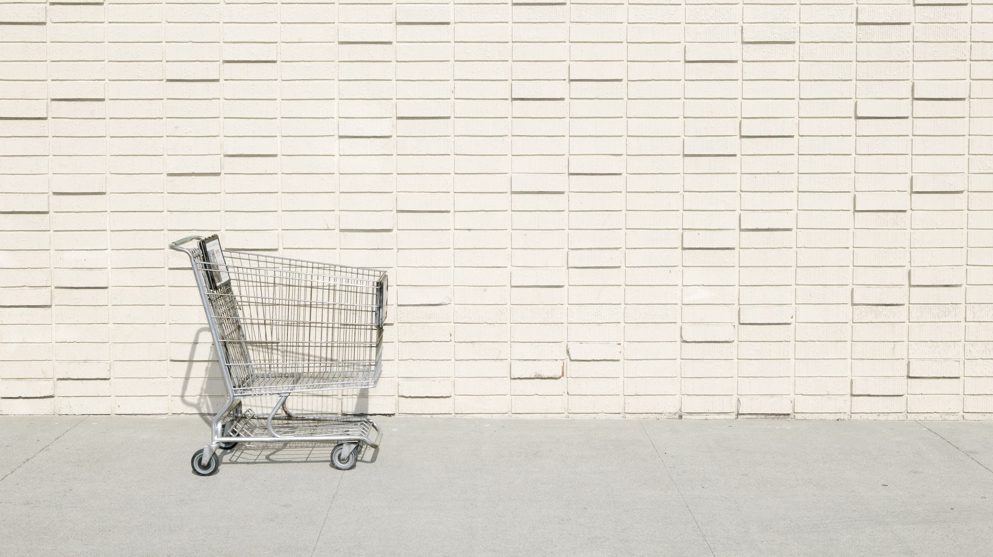
Generic Tags

Slide 5
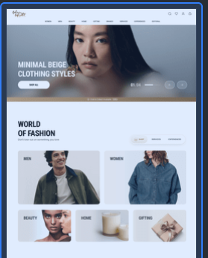
On any banner/image/widget
click

Slide 6
Click Type | Tracking Type | Launch variables | Expected Values
Any Banner click or Widget click | All CTAs | digitalData={ linkName : “banner click", channel: "<web/msite>|<page name without the word “page”>", // eg : home, category, customerID : "<customerID>", // only pass when available linkPageName: “<page name>", //the name of the page from where the product was clicked, eg : home page, product listing page , etc. loginStatus : "<logged-in/guest>" , icid : "<page type>|<banner name/image name>|<widget name>|<category>|<cta name>|<cta position>", //if a banner or widget is clicked platform: "<desktop website/mobile website>", userDetails: "<gender>|<age>", // pass only when user is logged in dob: "<date of birth>" // pass only when user is logged in }; _satellite.track("generic-click"); | loginStatus may have the values:- logged-in guest icid will be passed when a banner or widget is clicked. icid should always be passed in the given format only. Pass na if any value is missing. Example value :- home page|na|sherwanis|sauve silhouettes|explore|1 // considering it as a widget, hero banner or image name will be passed as “na”. home page|sale|na|hero banner |explore|1 // considering it as a banner, here widget name will be passed as “na”. home page-sc|shirts|shop by category|banner click|1

Slide 7
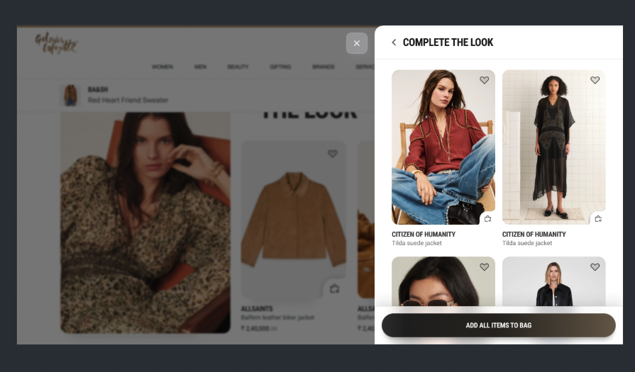
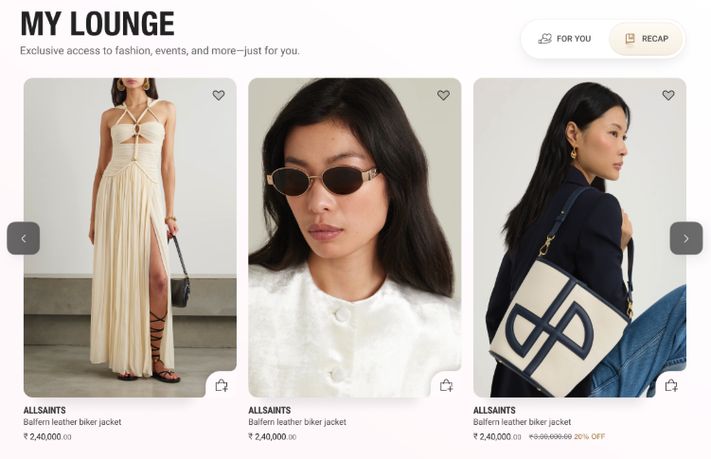
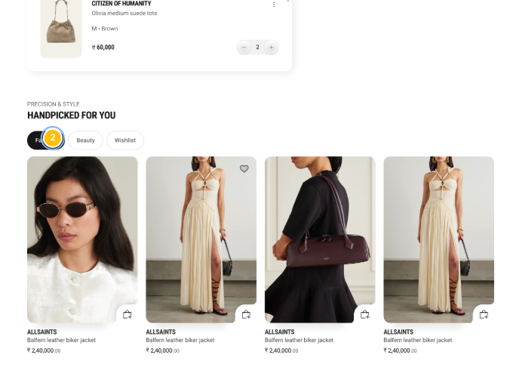
On Any Products click(from Home to Cart)

Slide 8
Click Type | Tracking Type | Launch variables | Expected Values
Product clicks | Product click | digitalData={ linkName:"product click", channel: "<web/msite>|<page name without the word “page”>", // eg : home, category, linkPageName: “<page name>", //the name of the page from where the product was clicked, eg : home page, product listing page , etc. customerID : "<customerID>", // only pass when available loginStatus : "<logged-in/guest>" , productID: "<product ID>", productCategory: "<product category>", productName: "<product name>", productPosition: “<position of the product clicked>”, productBrand: “<brand of the product>”, pfm : “<section of the page/ product finding source>”, platform: "<desktop website/mobile website>", userDetails: "<gender>|<age>", // pass only when user is logged in dob: "<date of birth>" // pass only when user is logged in }; _satellite.track("generic_clicked"); | loginStatus may have the values:- logged-in guest pfm means product finding method, the expected values will be the section of the page from where the user has found the product. Eg : “home product slider” “internal search” “internal campaign” “similar products” “top picks” “breadcrumb” “navigation/browsing” “promos” “wishlist/favorites” “collections” “cross-Sell” “campaign landing pages”

Slide 9
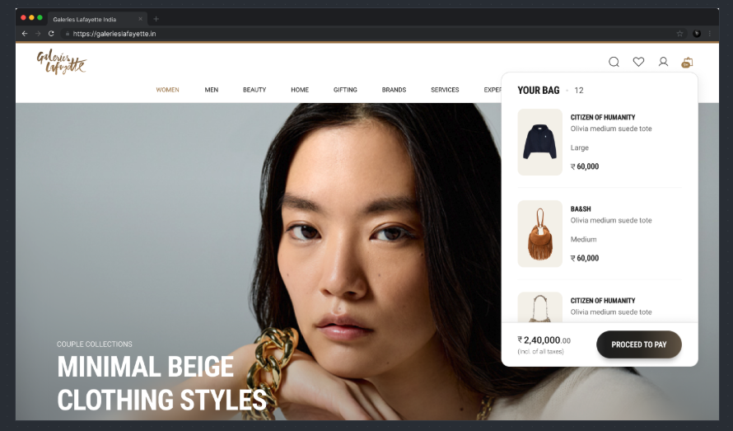
Click on proceed to pay

Slide 10
Click Type | Tracking Type | Launch variables | Expected Values
Buttons click | Proceed to pay | digitalData={ linkName:”proceed to pay", channel: "<web/msite>|<page name without the word “page”>", // eg : home, category, linkPageName: “your bag”, customerID : "<customerID>", // only pass when available loginStatus : "<logged-in/guest>" , platform: "<desktop website/mobile website>", userDetails: "<gender>|<age>", // pass only when user is logged in dob: "<date of birth>" // pass only when user is logged in }; _satellite.track("generic-click"); | loginStatus may have the values:- logged-in guest

Slide 11
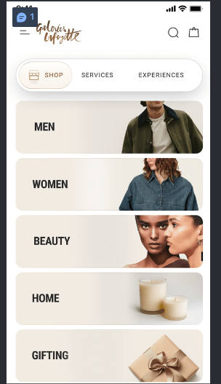
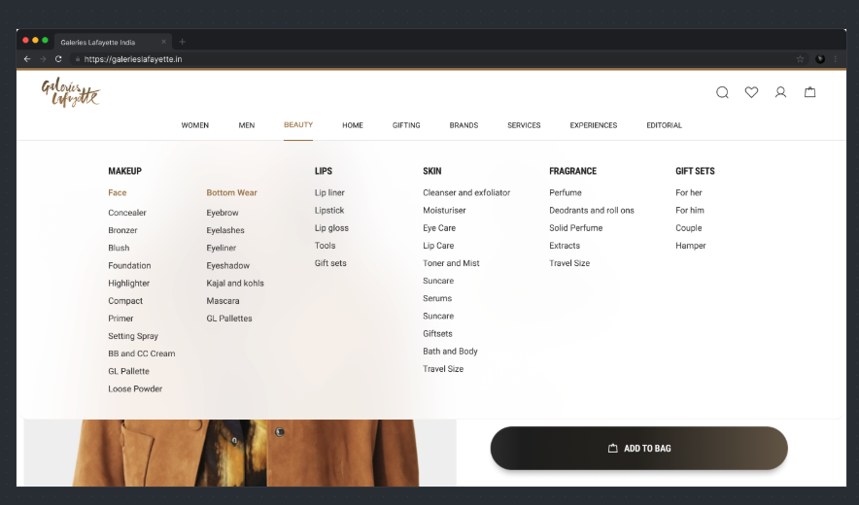
Menu Navigation

Slide 12
Click Type | Tracking Type | Launch variables | Expected Values
Menu Navigation | Menu CTAs | digitalData={ linkName: “menu navigation", channel: "<web/msite>|<page name without the word “page”>", // eg : home, product listing, linkPageName: ”<page name from where the menu was clicked", menuNavigation: “<section 1 : section 2 :…..section N>”, customerID : "<customerID>", // only pass when available loginStatus : "<logged-in/guest>" , platform: "<desktop website/mobile website>", userDetails: "<gender>|<age>", // pass only when user is logged in dob: "<date of birth>" // pass only when user is logged in }; _satellite.track("generic-click"); | loginStatus may have the values:- logged-in guest menuNavigation will have the value in the hierarchy Eg : menuNavigation : “beauty:lips:lipstick”,

Slide 13
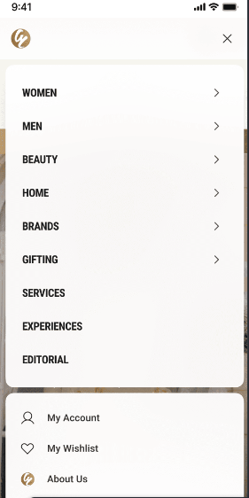
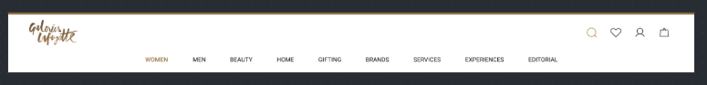
Header CTAs

Slide 14
Click Type | Tracking Type | Launch variables | Expected Values
Header CTAs | All CTAs | digitalData={ linkName:"<cta name>", channel: "<web/msite>|<page name without the word “page”>", // eg : home, product listing, linkPageName: ”<page name from where the icons/logo was clicked", customerID : "<customerID>", // only pass when available loginStatus : "<logged-in/guest>" , platform: "<desktop website/mobile website>", userDetails: "<gender>|<age>", // pass only when user is logged in dob: "<date of birth>" // pass only when user is logged in }; _satellite.track("generic-click"); | loginStatus may have the values:- logged-in guest <cta name> will have values like 1. logo 2. my wishlist 3. profile 4. cart 5. Find store 6. Track orders

Slide 15
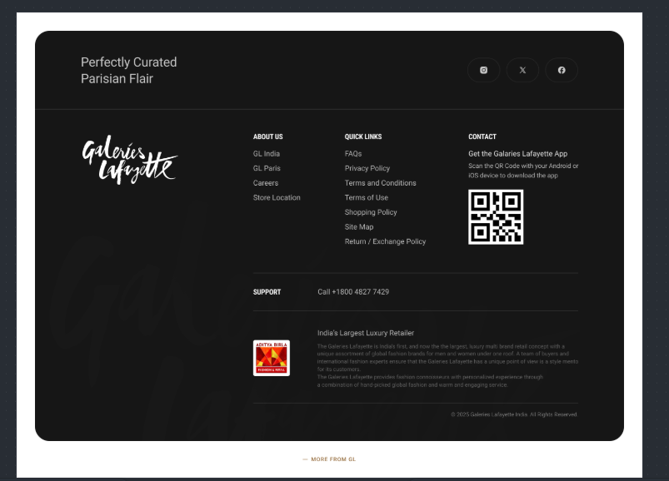
Footer All CTAs

Slide 16
Click Type | Tracking Type | Launch variables | Expected Values
Footer CTAs | All CTAs | digitalData={ linkName:"<cta name>", channel: "<web/msite>|<page name without the word “page”>", // eg : home, product listing, linkPageName: ”<page name from where the icons/logo was clicked", customerID : "<customerID>", // only pass when available loginStatus : "<logged-in/guest>" , platform: "<desktop website/mobile website>", userDetails: "<gender>|<age>", // pass only when user is logged in dob: "<date of birth>" // pass only when user is logged in }; _satellite.track("generic-click"); | loginStatus may have the values:- logged-in guest

Slide 17
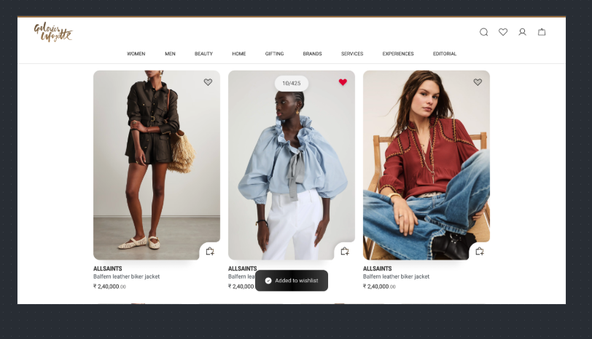
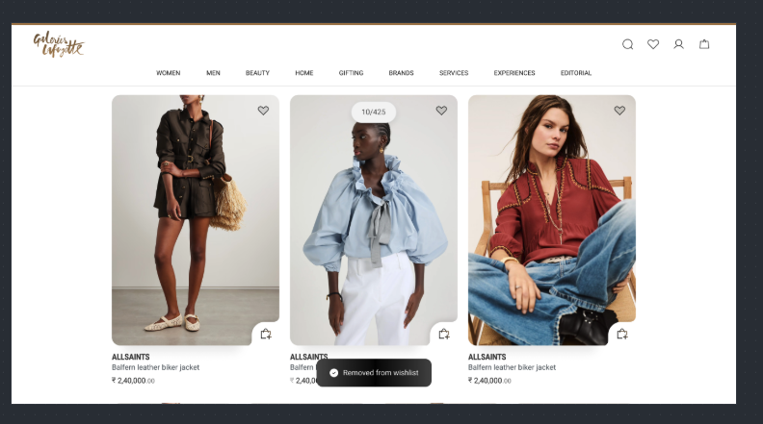
On wishlist add or remove

Slide 18
Click Type | Tracking Type | Launch variables | Expected Values
Add to wishlist | Icon | digitalData={ linkName: “<add to wishlist/remove from wishlist>", channel: "<web/msite>|<page name without the word “page”>", // eg : home, category, linkPageName: “< the page name from where this event happened", wishlistAdded : 1, // 1 as numeric value and key should only be passed when product will be move to wishlist. wishlistRemoved : 1, // 1 as numeric value and key should only be passed when product will be removed from wishlist. customerID : "<customerID>", // only pass when available loginStatus : "<logged-in/guest>" , productID: "<product ID>", productCategory: "<product category>", productName: "<product name>", productBrand: “<brand of the product>”, platform: "<desktop website/mobile website>", userDetails: "<gender>|<age>", // pass only when user is logged in dob: "<date of birth>" // pass only when user is logged in }; _satellite.track("generic_clicked"); | loginStatus may have the values:- logged-in guest productID: will have the value of SKU ID of the product. productCategory: will have the category of the product. productName: name of the product.

Slide 19
Sign in & Sign Up

Slide 20
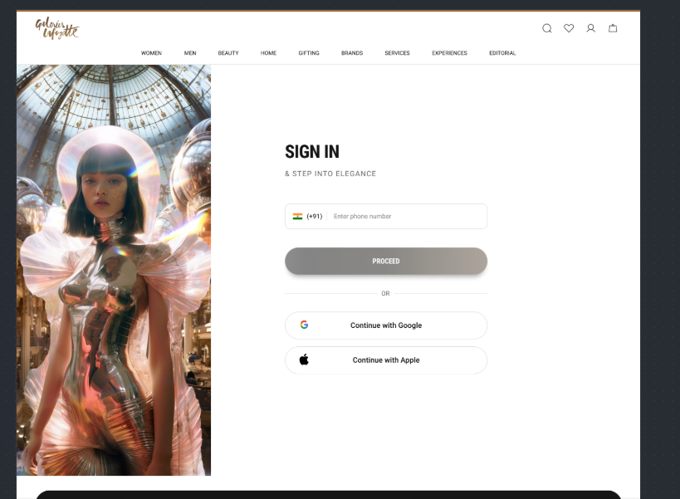
Identification Page Load

Slide 21
Page Type | Tracking Type | Launch variables | Expected Values
CI Page | onload | var digitalData={}; digitalData={ pageName: ”customer identification page", channel: "<web/msite>|login & registration", loginStatus : "guest" , pageType : “customer identification page" platform: "<desktop website/mobile website>", }; _satellite.track("generic-vp");

Slide 22
All CTA’s

Slide 23
Click Type | Tracking Type | Launch variables | Expected Values
Buttons click | All CTAs | digitalData={ linkName:"<cta name>", channel: "<web/msite>|login & registration", linkPageName: ”customer identification page", loginStatus : "guest" , platform: "<desktop website/mobile website>", }; _satellite.track("generic-click");

Slide 24
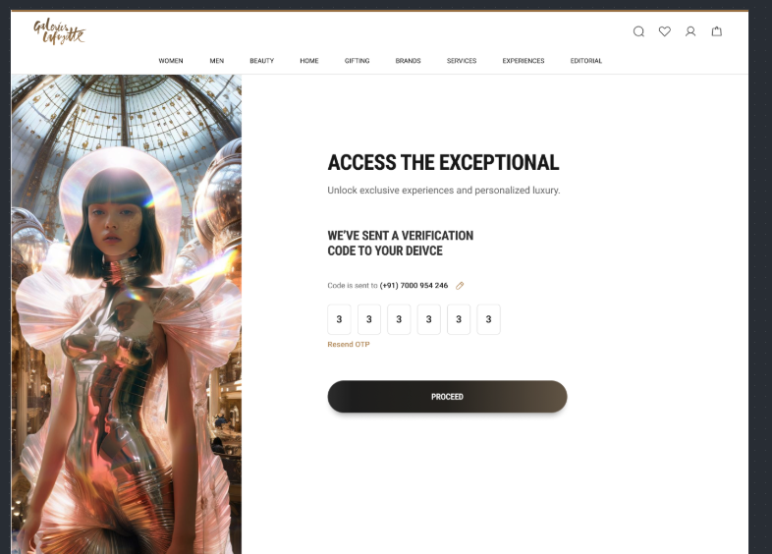
Sign in – OTP verify

Slide 25
Page Type | Tracking Type | Launch variables | Expected Values
Sign In - OTP | onload | var digitalData={}; digitalData={ pageName: ”sign in–otp verify", channel: "<web/msite>|login & registration", loginStatus : "guest" , pageType : “sign in–otp verify" platform: "<desktop website/mobile website>", }; _satellite.track("generic-vp");

Slide 26
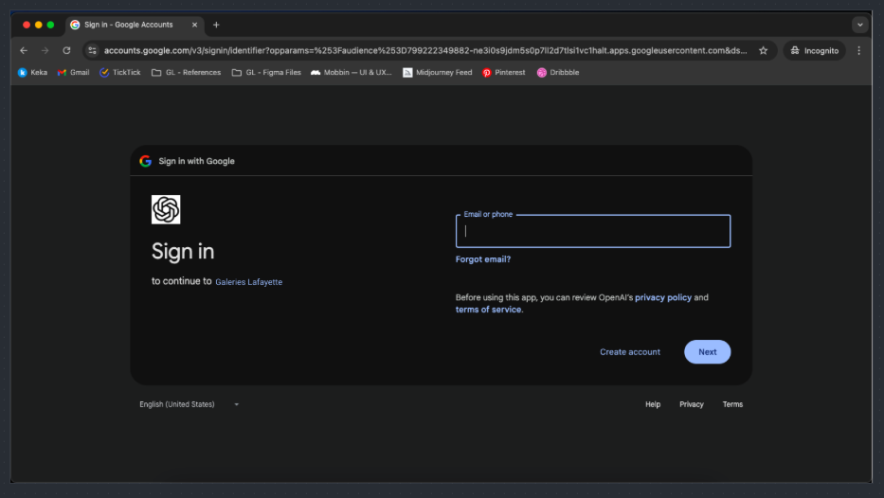
Sign in – Log in CTA click

Slide 27
Click Type | Tracking Type | Launch variables | Expected Values
Buttons click | Submit CTAs | digitalData={ linkName: “proceed", loginSuccess: 1 //1 will be passed as an integer value only when user has successfully login channel: "<web/msite>|login & registration", linkPageName: ”sign in-otp verify", customerID : "<customerID>", loginStatus : ”logged-in" ,, loginmethod: “mobile/email/google/apple”, platform: "<desktop website/mobile website>" }; _satellite.track("generic-click");

Slide 28
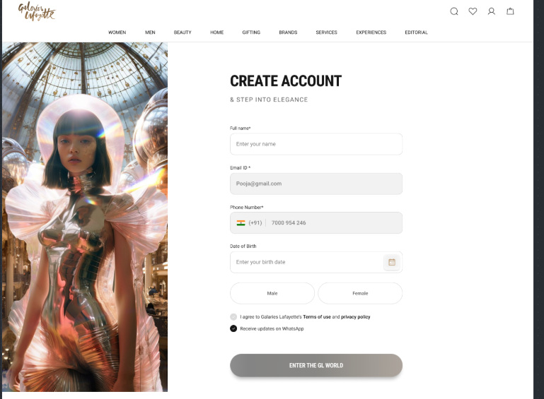
Sign Up Details Page

Slide 29
Page Type | Tracking Type | Launch variables | Expected Values
Sign Up | onload | var digitalData={}; digitalData={ pageName: ”create account page", channel: "<web/msite>|login & registration", loginStatus : "guest" , pageType : “create account page" platform: "<desktop website/mobile website>", }; _satellite.track("generic-vp");

Slide 30
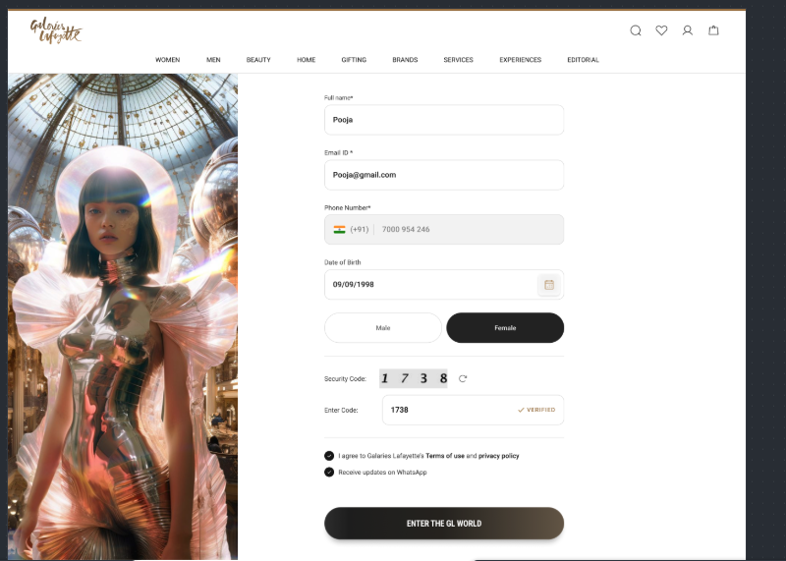
Sign Up – CTA’s click

Slide 31
Click Type | Tracking Type | Launch variables | Expected Values
Buttons click | Enter the gl world | digitalData={ linkName: “enter the gl world", regSuccess: 1 //1 will be passed as an integer value only when user has successfully registered channel: "<web/msite>|login & registration", linkPageName: ”create account page", customerID : "<customerID>", loginStatus : ”logged-in" , platform: "<desktop website/mobile website>", }; _satellite.track("generic-click");

Slide 32
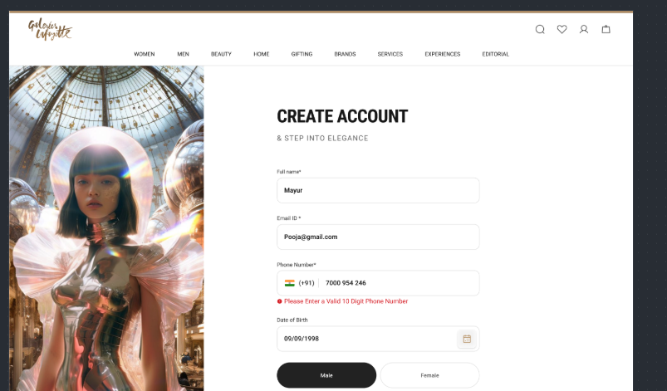
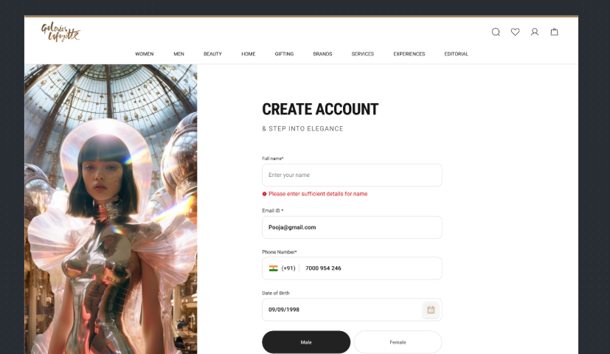
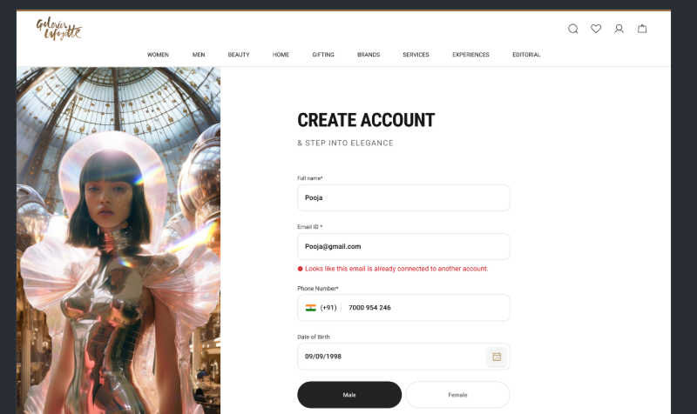
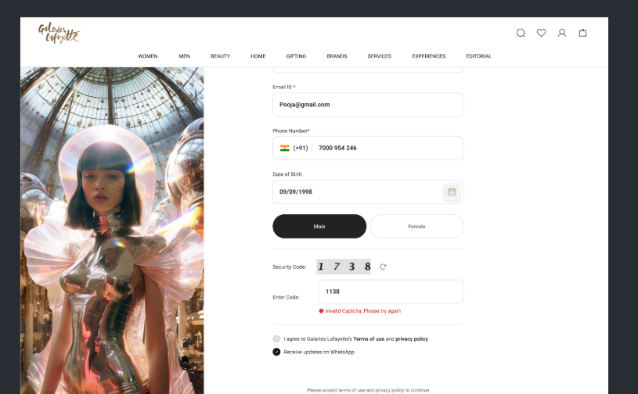
Sign In/Up – Error Tracking

Slide 33
Click Type | Tracking Type | Launch variables | Expected Values
Buttons click | All CTAs | digitalData={ linkName:”error tracking", channel: "<web/msite>|login & registration", linkPageName: ”customer identification page", error: “<error statement>”, loginStatus : "guest" , platform: "<desktop website/mobile website>", }; _satellite.track("generic-click");

Slide 34
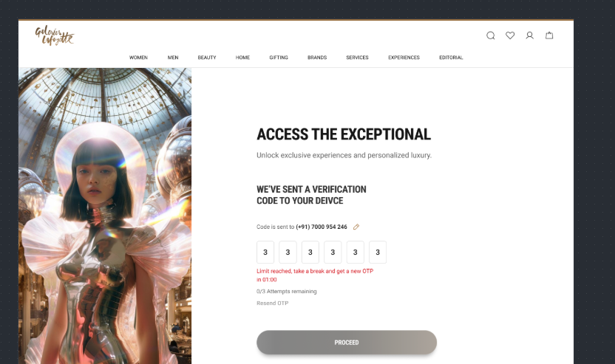
Sign In/Up – OTP Error Tracking

Slide 35
Click Type | Tracking Type | Launch variables | Expected Values
Buttons click | All CTAs | digitalData={ linkName: “otp error tracking", channel: "<web/msite>|login & registration", linkPageName: ”customer identification page", error: “<OTP error statement>”, loginStatus : "guest" , platform: "<desktop website/mobile website>" }; _satellite.track("generic-click");

Slide 36
Home Page

Slide 37
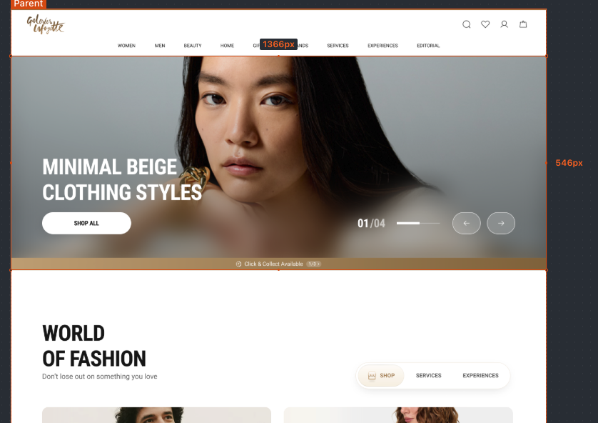
On the Load of Home Page

Slide 38
Page Type | Tracking Type | Launch variables | Expected Values
Home page | onload | var digitalData={}; digitalData={ pageName: "home page", channel: "<web/msite>|home", customerID : "<customerID>", // only pass when available loginStatus : "<logged-in/guest>" , pageType : “home page" platform: "<desktop website/mobile website>", userDetails: "<gender>|<age>", // pass only when user has logged in dob: "<date of birth>" // pass only when user has logged in }; _satellite.track("generic-vp"); | loginStatus may have the values:- logged-in guest

Slide 39
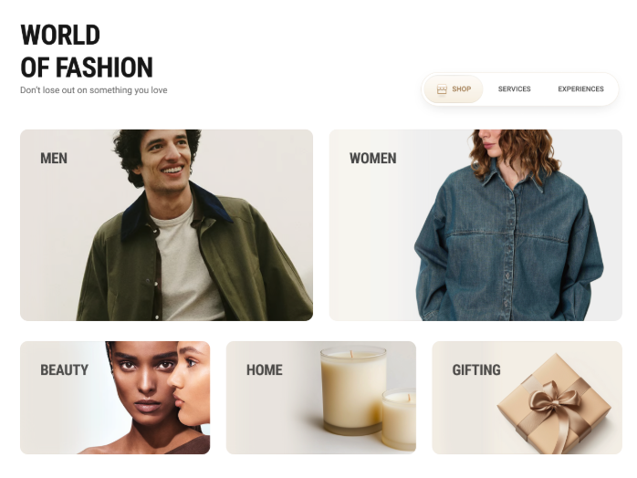
All Home page buttons click (excluding banner/widget and product clicks)

Slide 40
Click Type | Tracking Type | Launch variables | Expected Values
Buttons click | All CTAs | digitalData={ linkName:"<cta name>", channel: "<web/msite>|home", linkPageName: "home page", customerID : "<customerID>", // only pass when available loginStatus : "<logged-in/guest>" , platform: "<desktop website/mobile website>", userDetails: "<gender>|<age>", // pass only when user is logged in dob: "<date of birth>" // pass only when user is logged in }; _satellite.track("generic-click"); | loginStatus may have the values:- logged-in guest

Slide 41
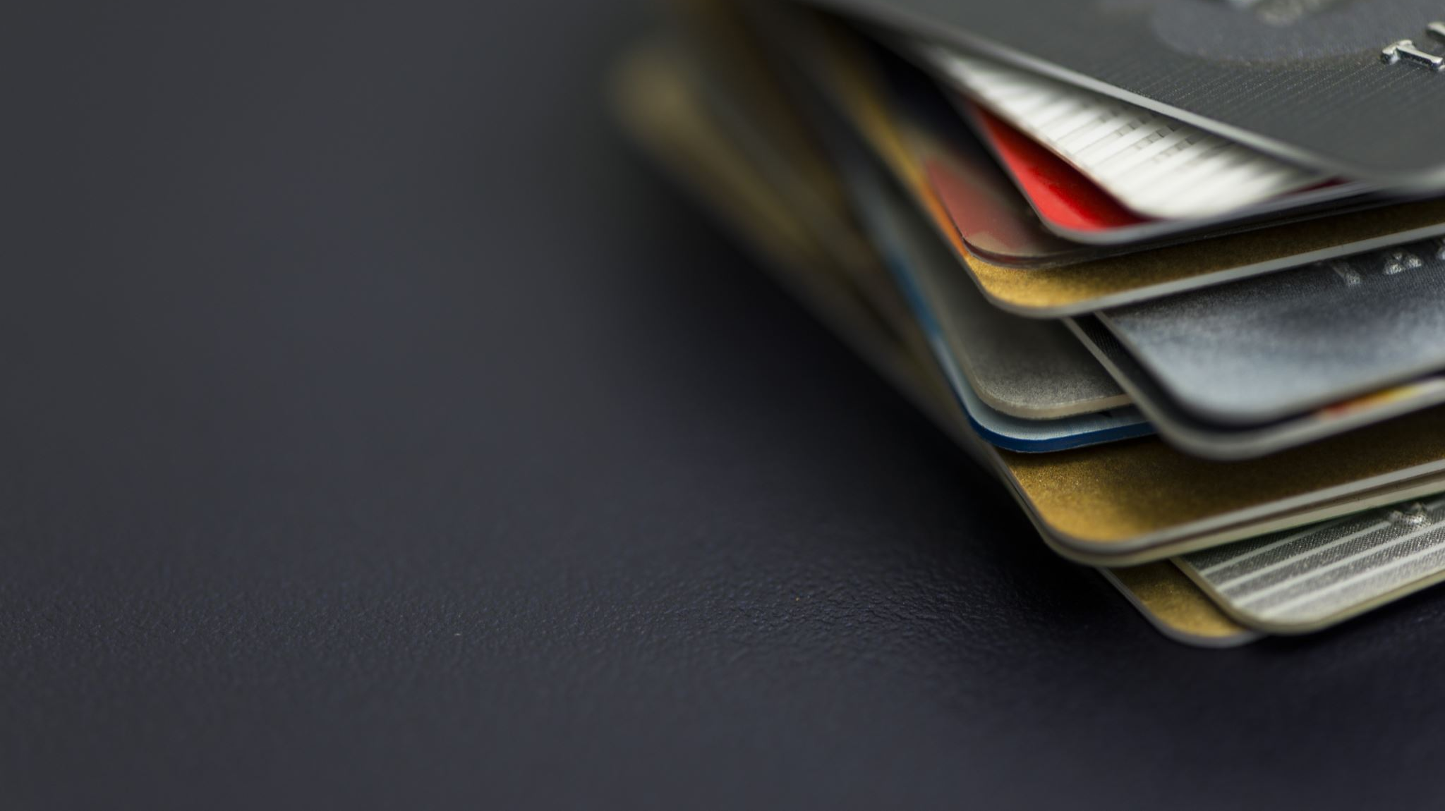
SLP

Slide 42
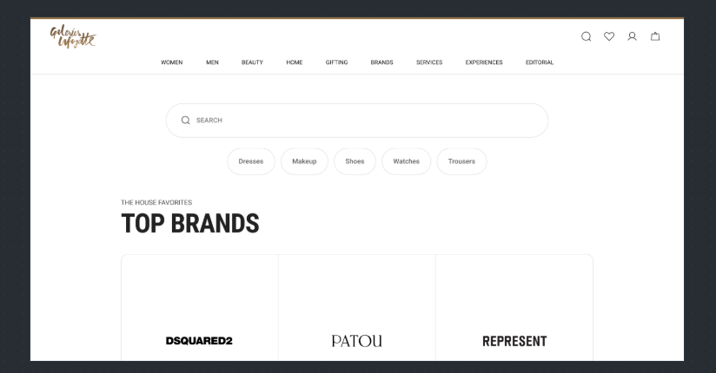
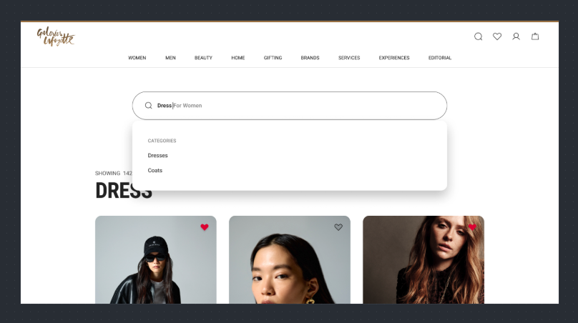
Search bar CTAs or recommended search CTA

Slide 43
Click Type | Tracking Type | Launch variables | Expected Values
Search bar CTA clicks | All CTAs | digitalData={ linkName: “search clicked", channel: "<web/msite>|<page name without the word “page”>", // eg : home, product listing, linkPageName: ”<page name from where the search was clicked", customerID : "<customerID>", // only pass when available loginStatus : "<logged-in/guest>" , searchKeyword: “<search keyword>”, platform: "<desktop website/mobile website>", userDetails: "<gender>|<age>", // pass only when user is logged in dob: "<date of birth>" // pass only when user is logged in }; _satellite.track("generic-click");

Slide 44
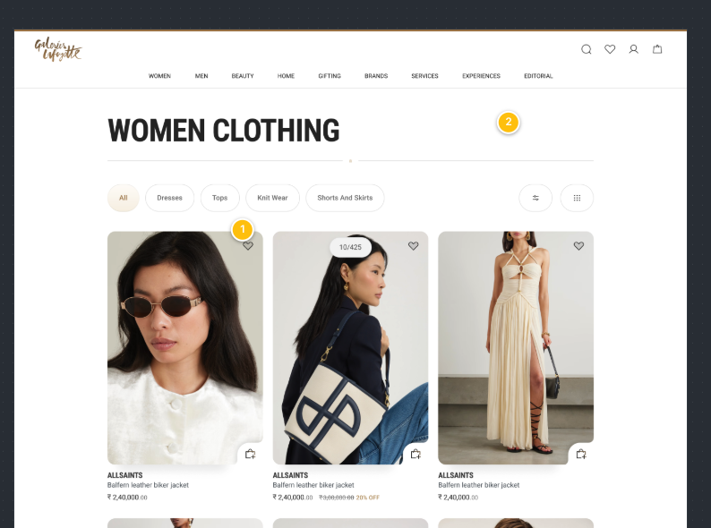
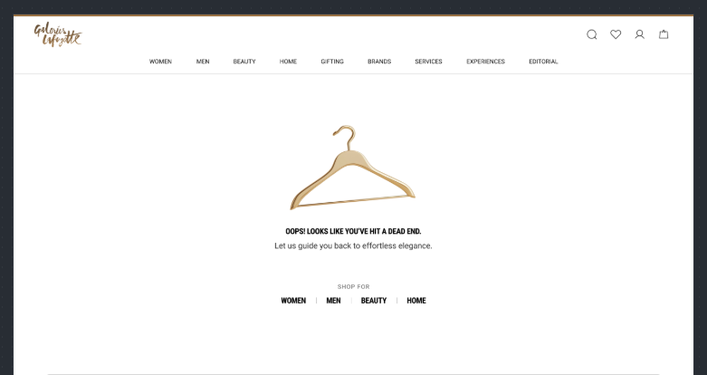
On Load of Search listing page

Slide 45
Page Type | Tracking Type | Launch variables | Expected Values
SLP page | onLoad | var digitalData={}; digitalData={ pageName: "product listing page", channel: "<web/msite>|product listing", customerID : "<customerID>", // only pass when available loginStatus : "<logged-in/guest>" , pageType : ”product listing page” searchKeyword: “<search keyword>”, searchType: “<type of the search>”, platform: "<desktop website/mobile website>", plpProductCategory : “products category”, searchProductCount:“<number of product count>”, // total number of products available for the search term. userDetails: "<gender>|<age>", // pass only when user has logged in dob: "<date of birth>" // pass only when user has logged in }; _satellite.track("generic-vp"); | loginStatus may have the values:- logged-in Guest Search Type will be – Normal Search – In case user have search from the entered keyword. Predictive Search – In case user have selected any recommended keyword during entering keyword Recent Search – Incase user selected any from the provided recent search term list. Trending Search – Incase user selected any from the provided trending search term list. Null Search – When no result available for the searched term.

Slide 46
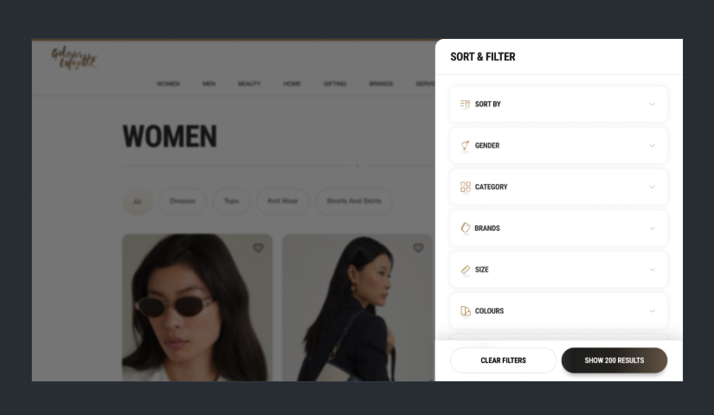
PLP : (Sort & Filter Click)

Slide 47
Click Type | Tracking Type | Launch variables | Expected Values
Sort By | dropdown | digitalData={ linkName: ”sort & filter", channel: "<web/msite>|product listing", linkPageName: ”product listing page", customerID : "<customerID>", // only pass when available loginStatus : "<logged-in/guest>" , plpProductCategory : “products category”, sortBy : “<sort by option>”, // only when user has manually sorted. filterName: “< filter 1 applied,filter 2 applied,…filter N applied>”. // only when filter is applied filterValue: “<filter 1 value, filter 2 value,….filter N value>” // only when filter is applied platform: "<desktop website/mobile website>", userDetails: "<gender>|<age>", // pass only when user is logged in dob: "<date of birth>" // pass only when user is logged in }; _satellite.track("generic-click"); | loginStatus may have the values:- logged-in guest In sortBy, expected values are new arrivals price, low to high

Slide 48
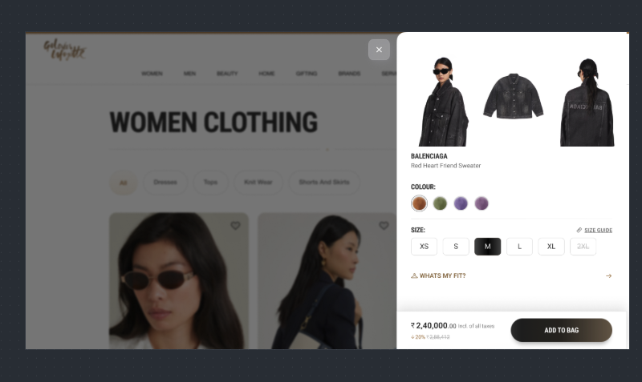
On SLP page, Add to cart click

Slide 49
Click Type | Tracking Type | Launch variables | Expected Values
Preview : Add to bag | Button | digitalData={ linkName: “add to bag", channel: "<web/msite>|product listing", linkPageName: ”product listing", addToCart: 1, //1 will be passed as an integer value only when user has added a product into the cart customerID : "<customerID>", // only pass when available loginStatus : "<logged-in/guest>" , productID: "<product ID>", productCategory: "<product category>", productSellPrice: "<product selling price,>", productQuantity: "<product quantity>", productName: "<product name>", stockStatus: "<product stock status>", color: "<product color>", size: "<product size>", productDiscount:"<product discount amount>", addToBagSource: “<page name or modal name from where product was added”>, platform: "<desktop website/mobile website>", userDetails: "<gender>|<age>", // pass only when user is logged in dob: "<date of birth>" // pass only when user is logged in }; _satellite.track("generic-click"); | loginStatus may have the values:- logged-in guest productID: will have the value of SKU ID of the product. productCategory: will have the category of the product. productSellPrice: will contain the actual selling price of the product. productQuantity: will have the quantity selected for the product. productName: name of the product. stockStatus: it will show the quantity of the product available in the stock. color: example values: Red. size: example values:- 42 L productDiscount will have the discount applied on the product.

Slide 50
PLP

Slide 51
On Load of Product listing page

Slide 52
Page Type | Tracking Type | Launch variables | Expected Values
PLP page | onLoad | var digitalData={}; digitalData={ pageName: "product listing page", channel: "<web/msite>|product listing", customerID : "<customerID>", // only pass when available loginStatus : "<logged-in/guest>" , pageType : "product listing page" platform: "<desktop website/mobile website>", plpProductCategory : “products category”, productCount:“<number of product count>“, userDetails: "<gender>|<age>", // pass only when user has logged in dob: "<date of birth>" // pass only when user has logged in }; _satellite.track("generic-vp"); | loginStatus may have the values:- logged-in guest

Slide 53
On PLP page, Add to cart click

Slide 54
Click Type | Tracking Type | Launch variables | Expected Values
Preview : Add to bag | Button | digitalData={ linkName: “add to bag", channel: "<web/msite>|product listing", linkPageName: ”product listing", addToCart: 1, //1 will be passed as an integer value only when user has added a product into the cart customerID : "<customerID>", // only pass when available loginStatus : "<logged-in/guest>" , productID: "<product ID>", productCategory: "<product category>", productSellPrice: "<product selling price,>", productQuantity: "<product quantity>", productName: "<product name>", stockStatus: "<product stock status>", color: "<product color>", size: "<product size>", productDiscount:"<product discount amount>", productBrand: “<brand of the product>”, addToBagSource: “<page name or modal name from where product was added”>, platform: "<desktop website/mobile website>", userDetails: "<gender>|<age>", // pass only when user is logged in dob: "<date of birth>" // pass only when user is logged in }; _satellite.track("generic-click"); | loginStatus may have the values:- logged-in guest productID: will have the value of SKU ID of the product. productCategory: will have the category of the product. productSellPrice: will contain the actual selling price of the product. productQuantity: will have the quantity selected for the product. productName: name of the product. stockStatus: it will show the quantity of the product available in the stock. color: example values: Red. size: example values:- 42 L productDiscount will have the discount applied on the product.

Slide 55
PLP : (Sort & Filter Click)

Slide 56
Click Type | Tracking Type | Launch variables | Expected Values
Sort By | dropdown | digitalData={ linkName: ”sort & filter", channel: "<web/msite>|product listing", linkPageName: ”product listing page", customerID : "<customerID>", // only pass when available loginStatus : "<logged-in/guest>" , plpProductCategory : “products category”, sortBy : “<sort by option>”, // only when user has manually sorted. filterName: “< filter 1 applied,filter 2 applied,…filter N applied>”. // only when filter is applied filterValue: “<filter 1 value, filter 2 value,….filter N value>” // only when filter is applied platform: "<desktop website/mobile website>", userDetails: "<gender>|<age>", // pass only when user is logged in dob: "<date of birth>" // pass only when user is logged in }; _satellite.track("generic-click"); | loginStatus may have the values:- logged-in guest In sortBy, expected values are new arrivals price, low to high

Slide 57
PDP

Slide 58
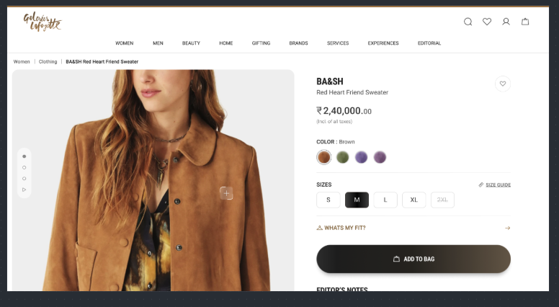
On PDP load

Slide 59
Page Type | Tracking Type | Launch variables | Expected Values
Product page | onLoad | var digitalData={}; digitalData={ pageName: "product page", channel: "<web/msite>|product", customerID : "<customerID>", // only pass when available loginStatus : "<logged-in/guest>", pageType : "product page", productID: "<product ID>", productCategory: "<product category>", productSellPrice: "<product selling price,>", productName: "<product name>", productBrand: “<brand of the product>”, platform: "<desktop website/mobile website>", userDetails: "<gender>|<age>", // pass only when user has logged in dob: "<date of birth>" // pass only when user has logged in }; _satellite.track("generic_load"); | loginStatus may have the values:- logged-in guest productID: will have the value of SKU ID of the product. productCategory: will have the category of the product. productSellPrice: will contain the actual selling price of the product. productName: name of the product.

Slide 60
On clicking on Add to bag

Slide 61
Click Type | Tracking Type | Launch variables | Expected Values
Buy now/ Add to bag | Button | digitalData={ linkName: “add to bag", channel: "<web/msite>|product", linkPageName: ”product page", addToCart: 1, //1 will be passed as an integer value only when user has added a product into the cart customerID : "<customerID>", // only pass when available loginStatus : "<logged-in/guest>" , productID: "<product ID>", productCategory: "<product category>", productSellPrice: "<product selling price,>", productQuantity: "<product quantity>", productName: "<product name>", stockStatus: "<product stock status>", addToBagSource: “<page name or modal name from where product was added”>, color: "<product color>", size: "<product size>", productBrand: “<brand of the product>”, productDiscount:"<product discount amount>", platform: "<desktop website/mobile website>", userDetails: "<gender>|<age>", // pass only when user is logged in dob: "<date of birth>" // pass only when user is logged in }; _satellite.track("generic-click"); | loginStatus may have the values:- logged-in guest productID: will have the value of SKU ID of the product. productCategory: will have the category of the product. productMarkPrice: will contain the MRP of the product. productSellPrice: will contain the actual selling price of the product. productQuantity: will have the quantity selected for the product. productName: name of the product. brandName: name of the brand of the product. stockStatus: it will show the quantity of the product available in the stock. color: example values: Red. size: example values:- 42 L productDiscount will have the discount applied on the product.

Slide 62
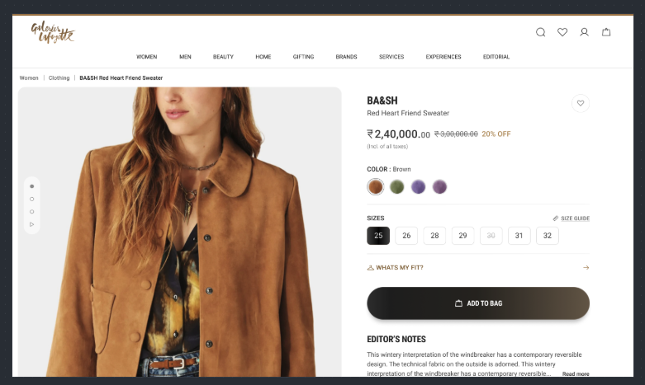
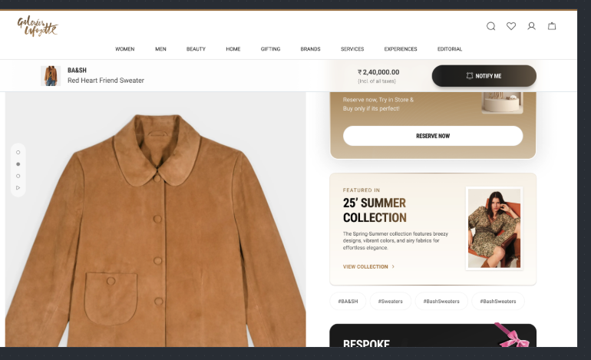
All CTA clicks(except add to bag and add to wishlist)

Slide 63
Click Type | Tracking Type | Launch variables | Expected Values
Product page clicks | All CTAs | digitalData={ linkName: "<cta name>", channel: "<web/msite>|product", linkPageName: "product page", customerID : "<customerID>", // only pass when available loginStatus : "<logged-in/guest>" , platform: "<desktop website/mobile website>", userDetails: "<gender>|<age>", // pass only when user is logged in dob: "<date of birth>" // pass only when user is logged in }; _satellite.track("generic-click"); | loginStatus may have the values:- logged-in guest // no call should be passed on Product zoom or product images

Slide 64
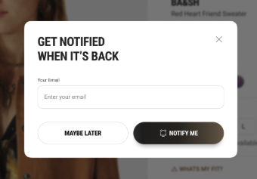
On PDP load

Slide 65
Page Type | Tracking Type | Launch variables | Expected Values
Get Notified Modal | onView | var digitalData={}; digitalData={ pageName: ”get notified", channel: "<web/msite>|product", parentPage : “product page” customerID : "<customerID>", // only pass when available loginStatus : "<logged-in/guest>", pageType : ”enter delivery pincode", platform: "<desktop website/mobile website>", userDetails: "<gender>|<age>", // pass only when user has logged in dob: "<date of birth>" // pass only when user has logged in }; _satellite.track("generic-vp"); | loginStatus may have the values:- logged-in guest productID: will have the value of SKU ID of the product. productCategory: will have the category of the product. productSellPrice: will contain the actual selling price of the product. productName: name of the product.

Slide 66
Get Notified Modal - Clicks

Slide 67
Click Type | Tracking Type | Launch variables | Expected Values
Get Notified Clicks | All CTAs | digitalData={ linkName: "<cta name>", channel: "<web/msite>|product", linkPageName: "product page", customerID : "<customerID>", // only pass when available loginStatus : "<logged-in/guest>" , platform: "<desktop website/mobile website>", userDetails: "<gender>|<age>", // pass only when user is logged in dob: "<date of birth>" // pass only when user is logged in }; _satellite.track("generic-click"); | loginStatus may have the values:- logged-in guest // no call should be passed on Product zoom or product images

Slide 68
Cart to Success

Slide 69
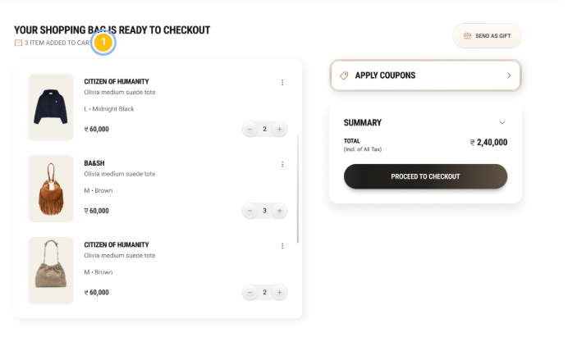
On cart page load

Slide 70
Page Type | Tracking Type | Launch variables | Expected Values
Cart page | onLoad | digitalData={​ pageName: "cart page",​ channel: ”<web/msite>|cart",​ customerID : "<customerID>", // only pass when available​ loginStatus : "<logged-in/guest>" ,​ pageType : "cart page”,​ productID: "<product 1 ID, product 2 ID,….product N ID>",​ productCategory: "<product 1 category, product 2 category,….product N category>",​ productSellPrice: "<product 1 selling price, product 2 selling price,…product N selling price>",​ productQuantity: "<product 1 quantity, product 2 quantity,…product N quantity>",​ productName: "<product 1 name, product 2 name,…product N name>",​ stockStatus: "<product 1 stock status, product 2 stock status,…product N stock status>",​ color: "<product 1 color, product 2 color,…product N color>",​ size: "<product 1 size, product 2 size,…product N size>",​ productDiscount:"<product 1 discount, product 2 discount,…product N discount>",​ productBrand: “<product 1 brand, product 2 brand,…product N brand>”, numberOfProducts: "<number of total Products available in the cart>",​ productAsGift: “<product 1 status>,<product 2 status>,…<product N status>”, platform: "<desktop website/mobile website>",​ userDetails: "<gender>|<age>", // pass only when user has logged in​ dob: "<date of birth>" // pass only when user is logged in // pass only when user has logged in​ };​ _satellite.track("generic-vp"); | loginStatus may have the values:- logged-in guest productID: will have the value of SKU ID of the product. productCategory: will have the category of the product. productSellPrice: will contain the actual selling price of the product. productName: name of the product. stockStatus: it will show the quantity of the product available in the stock. color: example values: Red. size: example values:- 42 L productDiscount will have the discount applied on the product. productAsGift: “yes,no,…yes”, by default it will be “no”.

Slide 71
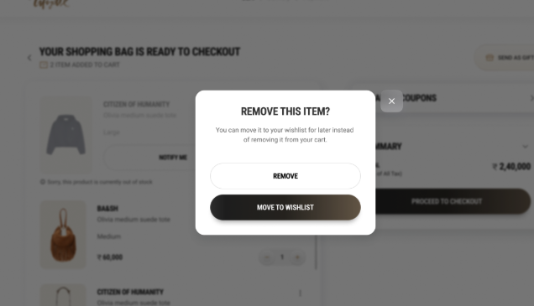
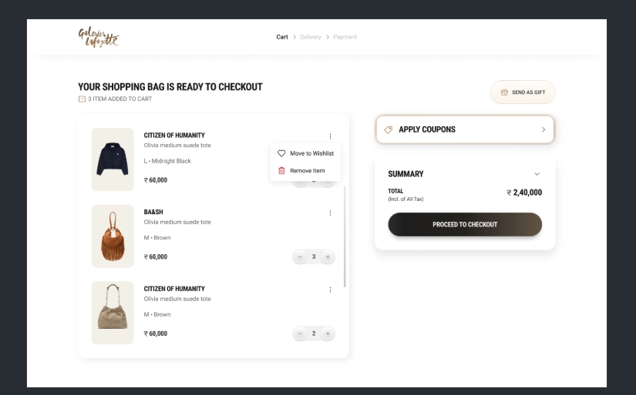
On click of product remove

Slide 72
Click Type | Tracking Type | Launch variables | Expected Values
Product Remove | Button | digitalData={ linkName: “remove product", channel: "<web/msite>|cart", linkPageName: ”cart page", removefromcart: 1, //1 will be passed as an integer value only when user has removed a product from the cart customerID : "<customerID>", // only pass when available loginStatus : "<logged-in/guest>" , productID: "<product ID>", productCategory: "<product category>", productSellPrice: "<product selling price,>", productQuantity: "<product quantity>", productName: "<product name>", stockStatus: "<product stock status>", color: "<product color>", size: "<product size>", productBrand: “<brand of the product>”, productDiscount:"<product discount amount>", productAsGift: “<product 1 status>,<product 2 status>,…<product N status>”, platform: "<desktop website/mobile website>", userDetails: "<gender>|<age>", // pass only when user is logged in dob: "<date of birth>" // pass only when user is logged in }; _satellite.track("generic-click"); | loginStatus may have the values:- logged-in guest productID: will have the value of SKU ID of the product. productCategory: will have the category of the product. productMarkPrice: will contain the MRP of the product. productSellPrice: will contain the actual selling price of the product. productQuantity: will have the quantity selected for the product. productName: name of the product. brandName: name of the brand of the product. stockStatus: it will show the quantity of the product available in the stock. color: example values: Red. size: example values:- 42 L productDiscount will have the discount applied on the product. productAsGift: “yes,no,…yes”, by default it will be “no”.

Slide 73
On click of move to wishlist

Slide 74
Click Type | Tracking Type | Launch variables | Expected Values
Add to wishlist | Icon | digitalData={ linkName: “<add to wishlist/remove from wishlist>", channel: "<web/msite>|<page name without the word “page”>", // eg : home, category, linkPageName: “< the page name from where this event happened", wishlistAdded : 1, // 1 as numeric value and key should only be passed when product will be move to wishlist. customerID : "<customerID>", // only pass when available loginStatus : "<logged-in/guest>" , productID: "<product ID>", productCategory: "<product category>", productName: "<product name>", productBrand: “<brand of the product>”, platform: "<desktop website/mobile website>", userDetails: "<gender>|<age>", // pass only when user is logged in dob: "<date of birth>" // pass only when user is logged in }; _satellite.track("generic_clicked"); | loginStatus may have the values:- logged-in guest productID: will have the value of SKU ID of the product. productCategory: will have the category of the product. productName: name of the product.

Slide 75
On successful response for quantity update

Slide 76
Click Type | Tracking Type | Launch variables | Expected Values
Product Increment​/decrement | dropdown button​ | digitalData={​ linkName:“<product quantity increased/product quantity decreased>",​ channel:”<web/msite>|cart",​ linkPageName: "cart page",​ customerID : "<customerID>", // only pass when available​ productID: "<product ID>",​ productCategory: "<product category>",​ productName: "<product name>",​ productBrand: “<brand of the product>”, platform: "<desktop website/mobile website>",​ userDetails: "<gender>|<age>", // pass only when user is logged in​ dob: "<date of birth>" // pass only when user is logged in​ };​ _satellite.track("generic_clicked");​ | loginStatus may have the values:- logged-in guest

Slide 77
On send as gift click

Slide 78
Click Type | Tracking Type | Launch variables | Expected Values
Send as gift | CTA button | digitalData={​ linkName:“send as gift",​ channel:”<web/msite>|cart",​ linkPageName: "cart page",​ customerID : "<customerID>", // only pass when available​ platform: "<desktop website/mobile website>",​ userDetails: "<gender>|<age>", // pass only when user is logged in​ dob: "<date of birth>" // pass only when user is logged in​ };​ _satellite.track("generic-click");​ | loginStatus may have the values:- logged-in guest

Slide 79
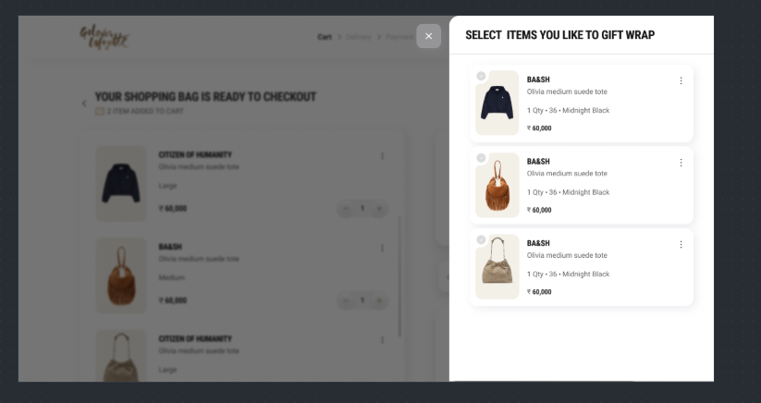
On send as gift view

Slide 80
Page Type | Tracking Type | Launch variables | Expected Values
Select item as gift modal | onView | var digitalData={}; digitalData={ pageName: ”select item as gift", channel: "<web/msite>|cart", parentPage : “cart page” customerID : "<customerID>", // only pass when available loginStatus : "<logged-in/guest>", pageType : ”enter delivery pincode", platform: "<desktop website/mobile website>", userDetails: "<gender>|<age>", // pass only when user has logged in dob: "<date of birth>" // pass only when user has logged in }; _satellite.track("generic-vp"); | loginStatus may have the values:- logged-in guest productID: will have the value of SKU ID of the product. productCategory: will have the category of the product. productSellPrice: will contain the actual selling price of the product. productName: name of the product.

Slide 81
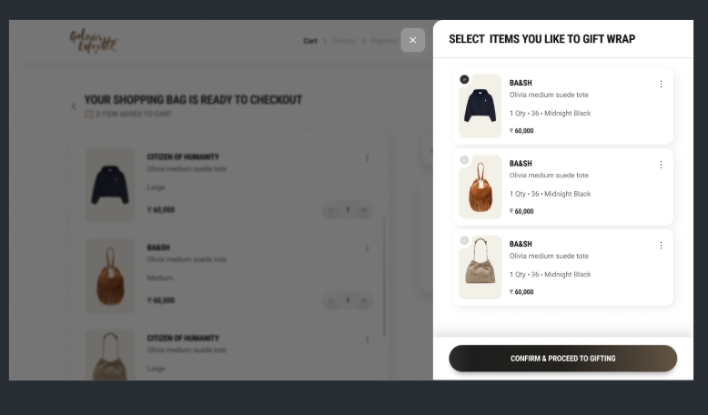
Select send as gift CTA

Slide 82
Click Type | Tracking Type | Launch variables | Expected Values
Multiple clicks | CTA button | digitalData={​ linkName:“<cta name>",​ channel:”<web/msite>|cart",​ linkPageName: "cart page",​ customerID : "<customerID>", // only pass when available​ platform: "<desktop website/mobile website>",​ userDetails: "<gender>|<age>", // pass only when user is logged in​ dob: "<date of birth>" // pass only when user is logged in​ };​ _satellite.track("generic-click");​ | loginStatus may have the values:- logged-in guest

Slide 83
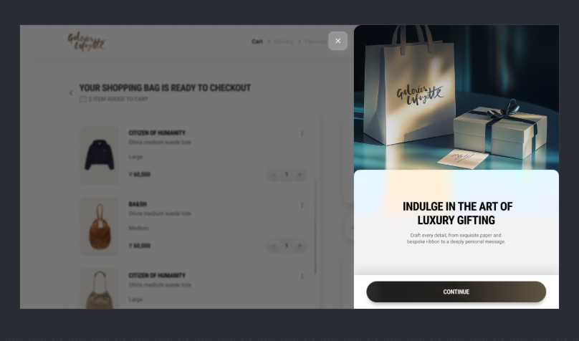
On gift wrap view

Slide 84
Page Type | Tracking Type | Launch variables | Expected Values
Wrap your Gift | onView | var digitalData={}; digitalData={ pageName: ”wrap your gift", channel: "<web/msite>|cart", parentPage : “cart page” customerID : "<customerID>", // only pass when available loginStatus : "<logged-in/guest>", pageType : ”enter delivery pincode", platform: "<desktop website/mobile website>", userDetails: "<gender>|<age>", // pass only when user has logged in dob: "<date of birth>" // pass only when user has logged in }; _satellite.track("generic-vp"); | loginStatus may have the values:- logged-in guest productID: will have the value of SKU ID of the product. productCategory: will have the category of the product. productSellPrice: will contain the actual selling price of the product. productName: name of the product.

Slide 85
On Continue Click

Slide 86
Click Type | Tracking Type | Launch variables | Expected Values
Continue CTA | CTA button | digitalData={​ linkName:“<cta name>",​ channel:”<web/msite>|cart",​ linkPageName: "cart page",​ customerID : "<customerID>", // only pass when available​ platform: "<desktop website/mobile website>",​ userDetails: "<gender>|<age>", // pass only when user is logged in​ dob: "<date of birth>" // pass only when user is logged in​ };​ _satellite.track("generic-click");​ | loginStatus may have the values:- logged-in guest

Slide 87
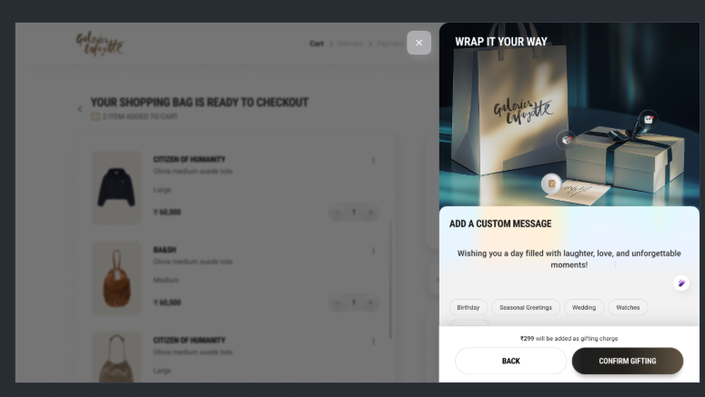
On Continue Click

Slide 88
Click Type | Tracking Type | Launch variables | Expected Values
confirm gifting | CTA button | digitalData={​ linkName:“<cta name>",​ channel:”<web/msite>|cart",​ linkPageName: "cart page",​ customerID : "<customerID>", // only pass when available​ platform: "<desktop website/mobile website>",​ userDetails: "<gender>|<age>", // pass only when user is logged in​ dob: "<date of birth>" // pass only when user is logged in​ };​ _satellite.track("generic-click");​ | loginStatus may have the values:- logged-in guest

Slide 89
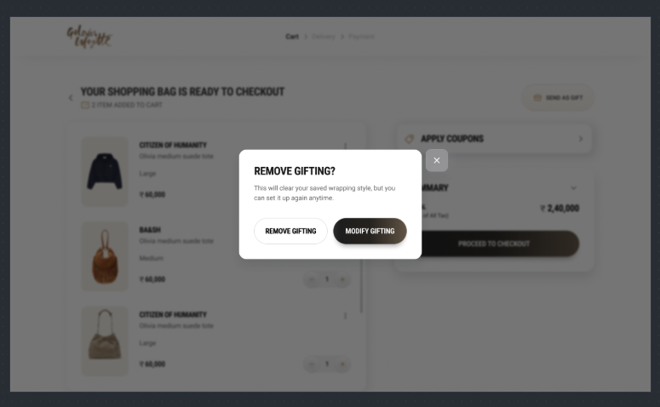
On review gifting view

Slide 90
Page Type | Tracking Type | Launch variables | Expected Values
Review gifting | onView | var digitalData={}; digitalData={ pageName: ”review gifting", channel: "<web/msite>|cart", parentPage : “cart page” customerID : "<customerID>", // only pass when available loginStatus : "<logged-in/guest>", pageType : ”enter delivery pincode", platform: "<desktop website/mobile website>", userDetails: "<gender>|<age>", // pass only when user has logged in dob: "<date of birth>" // pass only when user has logged in }; _satellite.track("generic-vp"); | loginStatus may have the values:- logged-in guest productID: will have the value of SKU ID of the product. productCategory: will have the category of the product. productSellPrice: will contain the actual selling price of the product. productName: name of the product.

Slide 91
On CTA clicks

Slide 92
Click Type | Tracking Type | Launch variables | Expected Values
Multiple clicks | CTA button | digitalData={​ linkName:“<cta name>",​ channel:”<web/msite>|cart",​ linkPageName: "cart page",​ customerID : "<customerID>", // only pass when available​ platform: "<desktop website/mobile website>",​ userDetails: "<gender>|<age>", // pass only when user is logged in​ dob: "<date of birth>" // pass only when user is logged in​ };​ _satellite.track("generic-click");​ | loginStatus may have the values:- logged-in guest

Slide 93
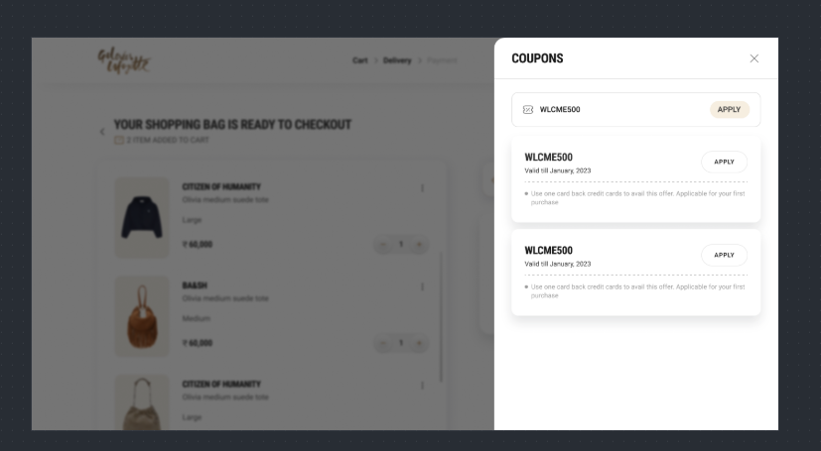
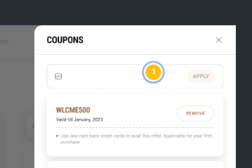
On click of Apply/Remove code

Slide 94
Click Type | Tracking Type | Launch variables | Expected Values
Coupon Apply/Remove | button | digitalData={​ linkName: “<coupon apply/remove coupon>",​ channel:”<web/msite>|cart",​ linkPageName: "cart page",​ customerID : "<customerID>", // only pass when available​ loginStatus : "<logged-in/guest>" ,​ appliedCouponCode: "<coupon code>-<offer value>”, // only when coupon is applied removedCouponcode:"<coupon code>-<offer value>”, // only when coupon is removed platform: "<desktop website/mobile website>",​ userDetails: "<gender>|<age>", // pass only when user is logged in​ dob: "<date of birth>" // pass only when user is logged in​ };​ _satellite.track("generic-click"); | loginStatus may have the values:- logged-in Guest appliedCouponCode: If a coupon is applied as per below example:-​ If coupon code is Welcome500, Additional 10% off, which save Rs 1500 on the order value. appliedCouponCode: “Welcome500-1500"

Slide 95
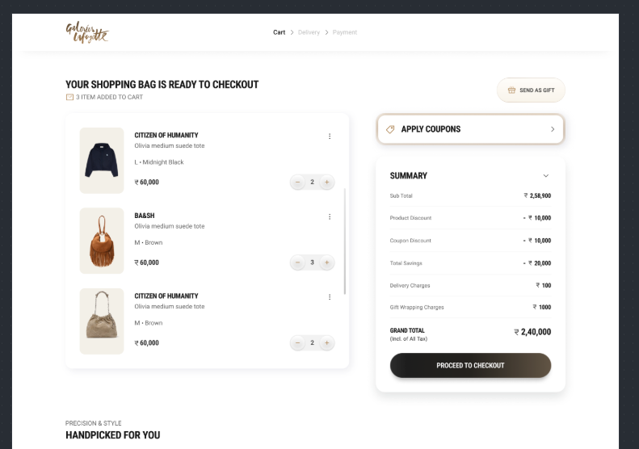
On click of proceed

Slide 96
Click Type | Tracking Type | Launch variables | Expected Values
Proceed to checkout | Button | digitalData={ linkName: “proceed to checkout", channel: "<web/msite>|cart", linkPageName: ”cart page", customerID : "<customerID>", // only pass when available loginStatus : "<logged-in/guest>" , productID: "<product 1 ID, product 2 ID,….product N ID>",​ productCategory: "<product 1 category, product 2 category,….product N category>",​ productSellPrice: "<product 1 selling price, product 2 selling price,…product N selling price>",​ productQuantity: "<product 1 quantity, product 2 quantity,…product N quantity>",​ productName: "<product 1 name, product 2 name,…product N name>",​ stockStatus: "<product 1 stock status, product 2 stock status,…product N stock status>",​ color: "<product 1 color, product 2 color,…product N color>",​ size: "<product 1 size, product 2 size,…product N size>",​ productDiscount:"<product 1 discount, product 2 discount,…product N discount>",​ productBrand: “<product 1 brand, product 2 brand,…product N brand>”, productAsGift: “<product 1 status>,<product 2 status>,…<product N status>”, userDetails: "<gender>|<age>", // pass only when user is logged in dob: "<date of birth>" // pass only when user is logged in }; _satellite.track("generic-click"); | loginStatus may have the values:- logged-in guest productID: will have the value of SKU ID of the product. productCategory: will have the category of the product. productMarkPrice: will contain the MRP of the product. productSellPrice: will contain the actual selling price of the product. productQuantity: will have the quantity selected for the product. productName: name of the product. brandName: name of the brand of the product. stockStatus: it will show the quantity of the product available in the stock. color: example values: Red. size: example values:- 42 L productDiscount will have the discount applied on the product. productAsGift: “yes,no,…yes”, by default it will be “no”.

Slide 97
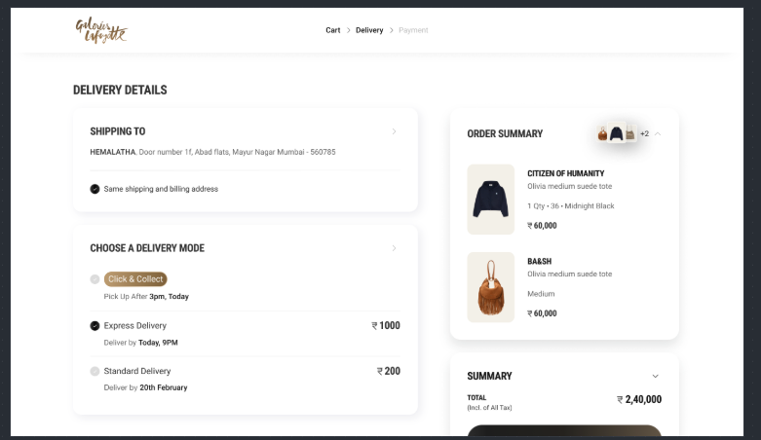
Delivery Page

Slide 98
Page Type | Tracking Type | Launch variables | Expected Values
Delivery page | onLoad | digitalData={​ pageName: ”delivery page",​ channel: ”<web/msite>|cart",​ customerID : "<customerID>", // only pass when available​ loginStatus : "<logged-in/guest>" ,​ pageType : ”delivery page”,​ productID: "<product 1 ID, product 2 ID,….product N ID>",​ productCategory: "<product 1 category, product 2 category,….product N category>",​ productSellPrice: "<product 1 selling price, product 2 selling price,…product N selling price>",​ productQuantity: "<product 1 quantity, product 2 quantity,…product N quantity>",​ productName: "<product 1 name, product 2 name,…product N name>",​ stockStatus: "<product 1 stock status, product 2 stock status,…product N stock status>",​ color: "<product 1 color, product 2 color,…product N color>",​ size: "<product 1 size, product 2 size,…product N size>",​ productDiscount:"<product 1 discount, product 2 discount,…product N discount>",​ productBrand: “<product 1 brand, product 2 brand,…product N brand>”, productAsGift: “<product 1 status>,<product 2 status>,…<product N status>”, platform: "<desktop website/mobile website>",​ userDetails: "<gender>|<age>", // pass only when user has logged in​ dob: "<date of birth>" // pass only when user is logged in // pass only when user has logged in​ };​ _satellite.track("generic-vp"); | loginStatus may have the values:- logged-in guest productID: will have the value of SKU ID of the product. productCategory: will have the category of the product. productSellPrice: will contain the actual selling price of the product. productName: name of the product. stockStatus: it will show the quantity of the product available in the stock. color: example values: Red. size: example values:- 42 L productDiscount will have the discount applied on the product. productAsGift: “yes,no,…yes”, by default it will be “no”.

Slide 99
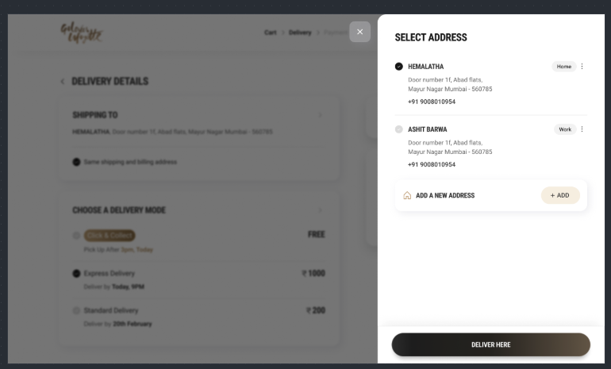
Select Address Load

Slide 100
Page Type | Tracking Type | Launch variables | Expected Values
Select Address | onLoad | var digitalData={}; digitalData={ pageName: ”select address", channel: "<web/msite>|cart", parentPage : “cart page” customerID : "<customerID>", // only pass when available loginStatus : "<logged-in/guest>", pageType : ”select address", platform: "<desktop website/mobile website>", userDetails: "<gender>|<age>", // pass only when user has logged in dob: "<date of birth>" // pass only when user has logged in }; _satellite.track("generic-vp"); | loginStatus may have the values:- logged-in guest

Slide 101
Delivery Here CTA

Slide 102
Click Type | Tracking Type | Launch variables | Expected Values
Deliver Here | button | digitalData={​ linkName: “<cta name>",​ channel:”<web/msite>|cart",​ linkPageName: ”select address",​ customerID : "<customerID>", // only pass when available​ loginStatus : "logged-in" ,​ platform: "<desktop website/mobile website>",​ userDetails: "<gender>|<age>", // pass only when user is logged in​ dob: "<date of birth>" // pass only when user is logged in​ };​ _satellite.track("generic-click"); | loginStatus may have the values:- logged-in

Slide 103
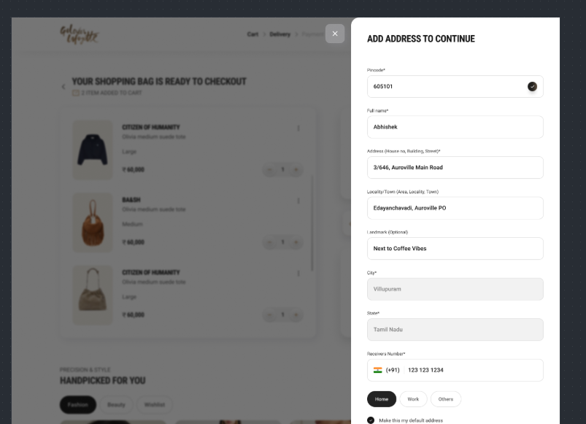
Add New Address View

Slide 104
Page Type | Tracking Type | Launch variables | Expected Values
Add new Address | onLoad | var digitalData={}; digitalData={ pageName: ”add new address", channel: "<web/msite>|cart", parentPage : “cart page” customerID : "<customerID>", // only pass when available loginStatus : "<logged-in/guest>", pageType : ”select address", platform: "<desktop website/mobile website>", userDetails: "<gender>|<age>", // pass only when user has logged in dob: "<date of birth>" // pass only when user has logged in }; _satellite.track("generic-vp"); | loginStatus may have the values:- logged-in guest

Slide 105

Save New Address

Slide 106
Click Type | Tracking Type | Launch variables | Expected Values
Save new address | button | digitalData={​ linkName: “<cta name>",​ channel:”<web/msite>|cart",​ linkPageName: ” add new address",​ customerID : "<customerID>", // only pass when available​ loginStatus : "logged-in" ,​ platform: "<desktop website/mobile website>",​ userDetails: "<gender>|<age>", // pass only when user is logged in​ dob: "<date of birth>" // pass only when user is logged in​ };​ _satellite.track("generic-click");

Slide 107

On click of proceed

Slide 108
Click Type | Tracking Type | Launch variables | Expected Values
Proceed to checkout | Button | digitalData={ linkName: “proceed to checkout", channel: "<web/msite>|cart", linkPageName: ”cart page", customerID : "<customerID>", // only pass when available loginStatus : "<logged-in/guest>" , productID: "<product 1 ID, product 2 ID,….product N ID>",​ productCategory: "<product 1 category, product 2 category,….product N category>",​ productSellPrice: "<product 1 selling price, product 2 selling price,…product N selling price>",​ productQuantity: "<product 1 quantity, product 2 quantity,…product N quantity>",​ productName: "<product 1 name, product 2 name,…product N name>",​ stockStatus: "<product 1 stock status, product 2 stock status,…product N stock status>",​ color: "<product 1 color, product 2 color,…product N color>",​ size: "<product 1 size, product 2 size,…product N size>",​ productDiscount:"<product 1 discount, product 2 discount,…product N discount>",​ productBrand: “<product 1 brand, product 2 brand,…product N brand>”, productAsGift: “<product 1 status>,<product 2 status>,…<product N status>”, deliveryType : <type of delivery opted>, deliveryCharges: “<delivery charges applied>”, userDetails: "<gender>|<age>", // pass only when user is logged in dob: "<date of birth>" // pass only when user is logged in }; _satellite.track("generic-click"); | loginStatus may have the values:- logged-in guest productID: will have the value of SKU ID of the product. productCategory: will have the category of the product. productMarkPrice: will contain the MRP of the product. productSellPrice: will contain the actual selling price of the product. productQuantity: will have the quantity selected for the product. productName: name of the product. brandName: name of the brand of the product. stockStatus: it will show the quantity of the product available in the stock. color: example values: Red. size: example values:- 42 L productDiscount will have the discount applied on the product. productAsGift: “yes,no,…yes”, by default it will be “no”.

Slide 109

Verify PAN Card

Slide 110
Page Type | Tracking Type | Launch variables | Expected Values
Verify pan card | onVIew | var digitalData={}; digitalData={ pageName: ”verify pan card-step1", channel: "<web/msite>|cart", parentPage : “cart page” customerID : "<customerID>", // only pass when available loginStatus : "<logged-in/guest>", pageType : ”select address", platform: "<desktop website/mobile website>", userDetails: "<gender>|<age>", // pass only when user has logged in dob: "<date of birth>" // pass only when user has logged in }; _satellite.track("generic-vp"); | loginStatus may have the values:- logged-in guest

Slide 111
CTA clicks

Slide 112
Click Type | Tracking Type | Launch variables | Expected Values
CTA clicks | button | digitalData={​ linkName: “<cta name>",​ channel:”<web/msite>|cart",​ linkPageName: ” verify pan card",​ customerID : "<customerID>", // only pass when available​ loginStatus : "logged-in" ,​ platform: "<desktop website/mobile website>",​ userDetails: "<gender>|<age>", // pass only when user is logged in​ dob: "<date of birth>" // pass only when user is logged in​ };​ _satellite.track("generic-click");

Slide 113

Verify PAN Card – Step 2

Slide 114
Page Type | Tracking Type | Launch variables | Expected Values
Verify pan card | onVIew | var digitalData={}; digitalData={ pageName: ”verify pan card-step2", channel: "<web/msite>|cart", parentPage : “cart page” customerID : "<customerID>", // only pass when available loginStatus : "<logged-in/guest>", pageType : ”select address", platform: "<desktop website/mobile website>", userDetails: "<gender>|<age>", // pass only when user has logged in dob: "<date of birth>" // pass only when user has logged in }; _satellite.track("generic-vp"); | loginStatus may have the values:- logged-in guest

Slide 115

CTA click

Slide 116
Click Type | Tracking Type | Launch variables | Expected Values
CTA clicks | button | digitalData={​ linkName: “<cta name>",​ channel:”<web/msite>|cart",​ linkPageName: ” verify pan card",​ customerID : "<customerID>", // only pass when available​ loginStatus : "logged-in" ,​ platform: "<desktop website/mobile website>",​ userDetails: "<gender>|<age>", // pass only when user is logged in​ dob: "<date of birth>" // pass only when user is logged in​ };​ _satellite.track("generic-click");

Slide 117

On checkout page load

Slide 118
Page Type | Tracking Type | Launch variables | Expected Values
checkout page | onLoad | digitalData={​ pageName: ”checkout page",​ channel: ”<web/msite>|checkout",​ customerID : "<customerID>", // only pass when available​ loginStatus : "<logged-in/guest>" ,​ pageType : ”checkout page”,​ productID: "<product 1 ID, product 2 ID,….product N ID>",​ productCategory: "<product 1 category, product 2 category,….product N category>",​ productSellPrice: "<product 1 selling price, product 2 selling price,…product N selling price>",​ productQuantity: "<product 1 quantity, product 2 quantity,…product N quantity>",​ productName: "<product 1 name, product 2 name,…product N name>",​ stockStatus: "<product 1 stock status, product 2 stock status,…product N stock status>",​ color: "<product 1 color, product 2 color,…product N color>",​ size: "<product 1 size, product 2 size,…product N size>",​ productDiscount:"<product 1 discount, product 2 discount,…product N discount>",​ productBrand: “<product 1 brand, product 2 brand,…product N brand>”, productAsGift: “<product 1 status>,<product 2 status>,…<product N status>”, deliveryType : <type of delivery opted>, deliveryCharges: “<delivery charges applied>”, platform: "<desktop website/mobile website>",​ userDetails: "<gender>|<age>", // pass only when user has logged in​ dob: "<date of birth>" // pass only when user is logged in // pass only when user has logged in​ };​ _satellite.track("generic-vp"); | loginStatus may have the values:- logged-in guest productID: will have the value of SKU ID of the product. productCategory: will have the category of the product. productSellPrice: will contain the actual selling price of the product. productName: name of the product. stockStatus: it will show the quantity of the product available in the stock. color: example values: Red. size: example values:- 42 L productDiscount will have the discount applied on the product. productAsGift: “yes,no,…yes”, by default it will be “no”.

Slide 119
On click of Place order

Slide 120
Click Type | Tracking Type | Launch variables | Expected Values
confirm Order | Button | digitalData={ linkName: “confirm order", channel: "<web/msite>|checkout", linkPageName: ”checkout page", customerID : "<customerID>", // only pass when available loginStatus : "<logged-in/guest>" , productID: "<product 1 ID, product 2 ID,….product N ID>",​ productCategory: "<product 1 category, product 2 category,….product N category>",​ productSellPrice: "<product 1 selling price, product 2 selling price,…product N selling price>",​ productQuantity: "<product 1 quantity, product 2 quantity,…product N quantity>",​ productName: "<product 1 name, product 2 name,…product N name>",​ stockStatus: "<product 1 stock status, product 2 stock status,…product N stock status>",​ color: "<product 1 color, product 2 color,…product N color>",​ size: "<product 1 size, product 2 size,…product N size>",​ productDiscount:"<product 1 discount, product 2 discount,…product N discount>", paymentMethod: “<payment method selected>”, productAsGift: “<product 1 status>,<product 2 status>,…<product N status>”, productBrand: “<product 1 brand, product 2 brand,…product N brand>”, deliveryType : <type of delivery opted>, deliveryCharges: “<delivery charges applied>”, userDetails: "<gender>|<age>", // pass only when user is logged in dob: "<date of birth>" // pass only when user is logged in }; _satellite.track("generic-click"); | loginStatus may have the values:- logged-in guest productID: will have the value of SKU ID of the product. productCategory: will have the category of the product. productMarkPrice: will contain the MRP of the product. productSellPrice: will contain the actual selling price of the product. productQuantity: will have the quantity selected for the product. productName: name of the product. brandName: name of the brand of the product. stockStatus: it will show the quantity of the product available in the stock. color: example values: Red. size: example values:- 42 L productDiscount will have the discount applied on the product. productAsGift: “yes,no,…yes”, by default it will be “no”.

Slide 121


Order Confirmation

Slide 122
Page Type | Tracking Type | Launch variables | Expected Values
Order success page | onLoad | digitalData={​ pageName: ”order confirmation page",​ channel: ”<web/msite>|order confirmation",​ customerID : "<customerID>", // only pass when available​ loginStatus : "<logged-in/guest>" ,​ pageType : ”order confirmation page”,​ orderID : “<order id>”, productsPurchased: “<total number of products purchased>”, expDeliveryDate: “<expected delivery date>”, totalRevenue: “<final amount paid by the customer>”, appliedCoupon: "<coupon code>-<offer value>”, paymentMethod: “<payment method selected>”, productID: "<product 1 ID, product 2 ID,….product N ID>",​ productCategory: "<product 1 category, product 2 category,….product N category>",​ productSellPrice: "<product 1 selling price, product 2 selling price,…product N selling price>",​ productQuantity: "<product 1 quantity, product 2 quantity,…product N quantity>",​ productName: "<product 1 name, product 2 name,…product N name>",​ productBrand: “<product 1 brand, product 2 brand,…product N brand>”, color: "<product 1 color, product 2 color,…product N color>",​ size: "<product 1 size, product 2 size,…product N size>",​ productDiscount:"<product 1 discount, product 2 discount,…product N discount>",​ productCouponDiscount:"<product 1coupon discount, product 2 coupon discount,…product N discount>",​ orderDiscount: “<order discount in amount>”, pass only when available productAsGift: “<product 1 status>,<product 2 status>,…<product N status>”, deliveryType : <type of delivery opted>, deliveryCharges: “<delivery charges applied>”, platform: "<desktop website/mobile website>",​ userDetails: "<gender>|<age>", // pass only when user has logged in​ dob: "<date of birth>" // pass only when user is logged in // pass only when user has logged in​ };​ _satellite.track("generic-vp"); | loginStatus may have the values:- logged-in guest productID: will have the value of SKU ID of the product. productCategory: will have the category of the product. productSellPrice: will contain the actual selling price of the product. productName: name of the product. color: example values: Red. size: example values:- 42 L productDiscount will have the discount applied on the product. productAsGift: “yes,no,…yes”, by default it will be “no”.

Slide 123
CTA Click continue shopping

Slide 124
Click Type | Tracking Type | Launch variables | Expected Values
success page | button | digitalData={​ linkName: “continue shopping",​ channel:”<web/msite>|order confirmation",​ linkPageName: “order confirmation",​ customerID : "<customerID>", // only pass when available​ loginStatus : "logged-in" ,​ platform: "<desktop website/mobile website>",​ userDetails: "<gender>|<age>", // pass only when user is logged in​ dob: "<date of birth>" // pass only when user is logged in​ };​ _satellite.track("generic-click");

Slide 125

Order Failure

Slide 126
Page Type | Tracking Type | Launch variables | Expected Values
Order failure | onLoad | digitalData={​ pageName: "order failure",​ channel: ”<web/msite>|order failure",​ customerID : "<customerID>", // only pass when available​ loginStatus : "<logged-in/guest>" ,​ pageType : ”order failure”,​ orderID : “<order id>”, failedproductsPurchased: “<total number of products>”, appliedCoupon: "<coupon code>-<offer value>”, totalfailedRevenue: “<final amount paid by the customer>”, paymentMethod: “<payment method selected>”, productID: "<product 1 ID, product 2 ID,….product N ID>",​ productCategory: "<product 1 category, product 2 category,….product N category>",​ productSellPrice: "<product 1 selling price, product 2 selling price,…product N selling price>",​ productQuantity: "<product 1 quantity, product 2 quantity,…product N quantity>",​ productName: "<product 1 name, product 2 name,…product N name>",​ productBrand: “<product 1 brand, product 2 brand,…product N brand>”, color: "<product 1 color, product 2 color,…product N color>",​ size: "<product 1 size, product 2 size,…product N size>",​ productDiscount:"<product 1 discount, product 2 discount,…product N discount>",​ failedorderDiscount: “<order discount in amount>”, pass only when available productAsGift: “<product 1 status>,<product 2 status>,…<product N status>”, deliveryType : <type of delivery opted>, deliveryCharges: “<delivery charges applied>”, platform: "<desktop website/mobile website>",​ userDetails: "<gender>|<age>", // pass only when user has logged in​ dob: "<date of birth>" // pass only when user is logged in // pass only when user has logged in​ };​ _satellite.track("generic-click"); | loginStatus may have the values:- logged-in guest productID: will have the value of SKU ID of the product. productCategory: will have the category of the product. productSellPrice: will contain the actual selling price of the product. productName: name of the product. color: example values: Red. size: example values:- 42 L productDiscount will have the discount applied on the product. productAsGift: “yes,no,…yes”, by default it will be “no”.

Slide 127
My Account

Slide 128

My Account – All Page Loads

Slide 129
Page Type | Tracking Type | Launch variables | Expected Values
Accounts | onLoad | var digitalData={}; digitalData={ pageName: ”<page name>", channel: "<web/msite>|my account", customerID : "<customerID>", // only pass when available loginStatus : "<logged-in/guest>", pageType : ”page name", platform: "<desktop website/mobile website>", userDetails: "<gender>|<age>", // pass only when user has logged in dob: "<date of birth>" // pass only when user has logged in }; _satellite.track("generic-vp"); | loginStatus may have the values:- logged-in Guest page name will be My orders My Wishlist GL Wallet Saved cards Saved addresses

Slide 130
Other Generic View & Clicks (Not related to products)

Slide 131
Page Type | Tracking Type | Launch variables | Expected Values
Generic Page/Modal Views | onload/onView | var digitalData={}; digitalData={ pageName: ”<page name>", channel: "<web/msite>|<page name without the word “page”>", // eg : home, category, customerID : "<customerID>", // only pass when available loginStatus : "<logged-in/guest>", pageType : ”page name", platform: "<desktop website/mobile website>", userDetails: "<gender>|<age>", // pass only when user has logged in dob: "<date of birth>" // pass only when user has logged in }; _satellite.track("generic-vp"); | loginStatus may have the values:- logged-in Guest
Click Type | Tracking Type | Launch variables | Expected Values
Generic other CTAs | Button/CTA | digitalData={​ linkName: “<cta name>",​ channel:”<web/msite>|<page name without the word “page”>", // eg : home, category, linkPageName: “<page name>", //the name of the page from where the CTA was clicked, eg : home page, product listing page , etc. customerID : "<customerID>", // only pass when available​ loginStatus : "logged-in" ,​ platform: "<desktop website/mobile website>",​ userDetails: "<gender>|<age>", // pass only when user is logged in​ dob: "<date of birth>" // pass only when user is logged in​ };​ _satellite.track("generic-click");

Slide 132
Error Tracking

Slide 133
Click Type | Tracking Type | Launch variables | Expected Values
On any error happened | All Errors | digitalData={ linkName:”error tracking", channel:”<web/msite>|<page name without the word “page”>", // eg : home, category, linkPageName: “<page name>", //the name of the page from where the CTA was clicked, eg : home page, product listing page , etc. error: “<error statement>”, loginStatus : ”<guest/logged-in>" , platform: "<desktop website/mobile website>", }; _satellite.track("generic-click");

